Slide 1
FIT3143
LECTURE WEEK 8
PART I
INTRODUCTION TO INSTRUCTION LEVEL PARALLELISM (ILP) PROCESSORS

Slide 2
Overview
Evolution and overview of ILP Processors
Understanding of inter-instruction dependencies
Data, Control and Resource Dependencies
What is instruction Scheduling?
Sequential Consistency
How fast can we go?
Learning outcome(s) related to this topic
Explain the fundamental principles of parallel computing architectures and algorithms (LO1)

Slide 3
Evolution of ILP Processors
Increasing processor performance has been provided by increased Instruction Level Parallelism (ILP)

Slide 4
Instruction Level Parallelism
Consider following code fragment
mul r3, r4 → r8
add r1, r2 → r7
load r6,(r1)
add #5, r5
Which instructions are unrelated?
Can be executed in any order
load r6,(r1)
mul r3,r4 → r8
add #5,r5
add r1,r2 → r7

Slide 5
Pipelining or parallel?
Internal operating principle of IFP processors
Pipelined operation
Parallel operation
FU
FU
FU
FU
FU
FU
m
1
2
m
1
2
Pipelined processors
Very Long Instruction Word (VLIW) and
Super scalar processors
FU: functional unit
Notes:
Instruction Fetch Pipeline
Functional Unit
Very Long Instruction Word

Slide 6
Pipelining
Fetch
Decode
Execute
Writeback
Cache/ Memory
F_{unit}
D_{unit}
E_{unit}
Register
File
F_{stage}
D_{cycle}
E_{stage}
W_{stage}
t_{c}
t_{c}
t_{c}
t_{c}
time

Slide 7
Machine Utilisation with pipelining
Machine
BUSY
Instr. 1
F₁
D₁
E₁
W₁
Instr. 2
F₂
D₂
E₂
W₂
Instr. 3
F₃
D₃
E₃
W₃
Instr. 4
F₄
D₄
E₄
W₄
Instr. 5
F₅
D₅
E₅
Instr. 6
F₆
D₆
F₇
Instr. 7
time
Notes:
The aim is to cancel out CPU idle time by always having sufficient workload in the pipeline.

Slide 8
VLIW Approach
Cache/
Memory
Fetch
Unit
Software scheduling
Parallel execution
Multiple ports to registers
Multiple instructions /word
EU
EU
EU
EU
Register
File
Notes:
Multiple dispatch ports, cache ports, register ports

Slide 9
Superscalar Approach
Cache/
Memory
Fetch
Unit
Hardware scheduling
Parallel execution
Multiple ports to registers
Dynamic Scheduling
EU
EU
EU
EU
Register
File

Slide 10
Out-of-order Execution (OOOE)
Look ahead in a window of instructions and find instructions that are ready to execute
Don’t depend on data from previous instructions still not executed
Resources are available
Out-of-order execution
Start instruction execution before execution of a previous instructions
Advantages:
Help exploit Instruction Level Parallelism (ILP)
Help cover latencies (e.g., L1 data cache miss, divide)
Can Compilers do the work ?
Compilers can statically reschedule instructions
Compilers do not have run time information
Conditional branch direction → limited to basic blocks
Data values, which may affect calculation time and control
Cache miss / hit

Slide 11
Dependencies between instructions
Data Dependencies
Future instructions depend on results of prior ones
Registers and Memory
Control Dependencies
Branch dependencies
Resource Dependencies
Number of ALUs, memory ports, etc
Notes:
ALU arithmetic logic unit

Slide 12
Data Dependencies
Data Dependencies in straight line code
Read After Write
dependency
(flow dependency)
Write After Read
dependency
(Anti-dependency)
Write After Write
dependency
(Output dependency)
Load-use
dependency
Define-use
dependency
True dependency
(Cannot be abandoned)
False dependency
(Can be eliminated by register renaming)

Slide 13
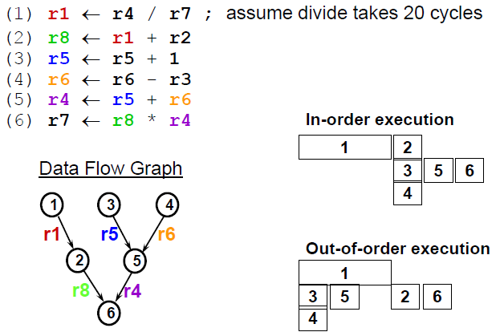
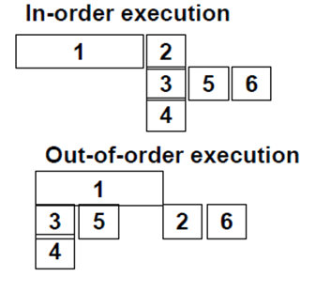
Data Flow Analysis
Example
; r1 depends on (1)
; r5 is independent
; r6 & r3 are independent
; r5 depends on (3); r6 depends on (4)
; r8 depends on (2); r4 depends on (5)

Slide 14
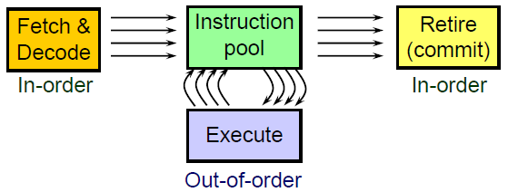
OOOE – General Scheme
Fetch & decode instructions in parallel but in order, to fill instruction pool
Execute ready instructions from the instructions pool
All the data required for the instruction is ready
Execution resources are available
Once an instruction is executed
signal all dependant instructions that data is ready
Commit instructions in parallel but in-order
Can commit an instruction only after all preceding instructions (in program order) have committed

Slide 15
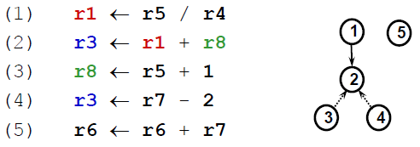
Example
Assume that executing a divide operation takes 20 cycles
Inst2 has a RAW dependency on r1 with Inst1
It cannot be executed in parallel with Inst1
Can successive instructions pass Inst2 ?
Inst3 cannot since Inst2 must read r8 before Inst3 writes to it
Inst4 cannot since it must write to r3 after Inst2
Inst5 can

Slide 16


False Dependencies
OOOE creates new dependencies
WAR: write to a register which is read by an earlier inst.
WAW: write to a register which is written by an earlier inst.
These are false dependencies
There is no missing data
Still prevent executing instructions out-of-order
Solution: Register Renaming

Slide 17
Register Renaming
Hold a pool of physical registers
Map architectural registers into physical registers
Before an instruction can be sent for execution
Allocate a free physical register from a pool
The physical register points to the architectural register
When an instruction writes a result
Write the result value to the physical register
When an instruction needs data from a register
Read data from the physical register allocated to the latest inst which writes to the same arch register, and precedes the current instruction
If no such instruction exists, read directly from the arch register
When an instruction commits
Move the value from the physical register to the arch register it points

Slide 18
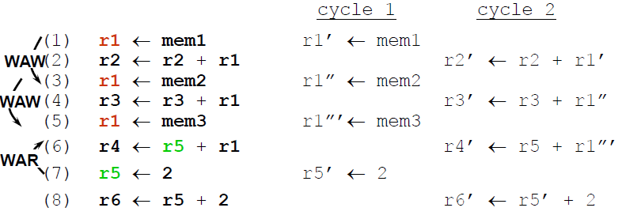
Example
Register Renaming Benefits
Removes false dependencies
Removes architecture limit for # of registers

Slide 19
Mapping to Physical Registers
Map to physical register
Cycle 1
Cycle 2
(1) r1 ← mem1 r1’ ← mem1
(2) r2 ← r2 + r1 r2’ ← r2 + r1’
Register renaming (map to another physical register)
(3) r1 ← mem2 r1’’ ← mem2
(4) r3 ← r3 + r1 r3’ ← r3 + r1’’
(5) r1 ← mem3 r1’’’ ← mem3
(6) r4 ← r5 + r1 r4’ ← r5 + r1’’’
(7) r5 ← 2 r5’ ← 2
(8) r6 ← r5 + 2 r6’ ← r5’ + 2
r1, r2, … , r6 is referring to the architectural register while r1', r1'' etc. are referring to physical registers. There can be multiple of them, depending on the processor.
The results from each instruction will only be committed to the architectural registers in the in-order retirement stage.

Slide 20
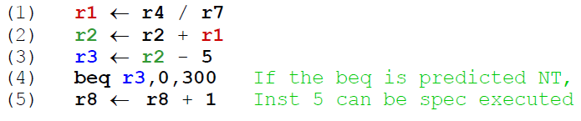
Executing Beyond Branches
So far we do not look for instructions ready to execute beyond a branch
Limited to the parallelism within a basic-block
A basic-block is ~5 instruction long
We would like to look beyond branches
But what if we execute an instruction beyond a branch and then it turns out that we predicted the wrong path ?
Solution: Speculative Execution

Slide 21
Speculative Execution
Execution of instructions from a predicted (yet unsure) path
Eventually, path may turn wrong
Implementation:
Hold a pool of all not yet executed instructions
Fetch instructions into the pool from a predicted path
Instructions for which all operands are ready can be executed
An instruction may change the processor state (commit) only when it is safe
An instruction commits only when all previous (in-order) instructions have committed instructions commit in-order
Instructions which follow a branch commit only after the branch commits
If a predicted branch is wrong all the instructions which follow it are flushed
Register Renaming helps speculative execution
Renamed registers are kept until speculation is verified to be correct

Slide 22
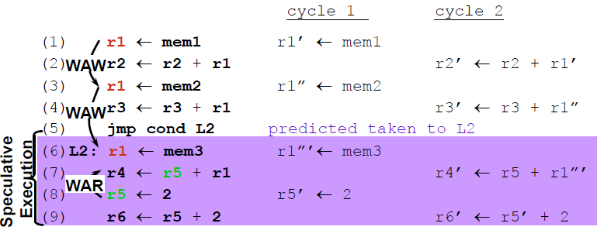
Example
Instructions 6-9 are speculatively executed
If the prediction turns wrong, they will be flushed
If the branch was predicted taken
The instructions from the other path would be have been speculatively executed

Slide 23
Data Dependencies in Loops
Not all data dependencies are obvious by examining the source code.
Consider
do I = 2, n
X(I) = A*X(I-1) + B
Recurrence between iteration I and I-1
Compiler needs to analyze loop expressions to detect and handle recurrences correctly.
Notes:
Note, the previous iteration value of X(I) is being used to calculate the current iteration’s X(I) value. Compiler if pipelining must consider the loop recurrence. The write in I-1 iteration must complete before read of Ith iteration begins – breaks standard pipelining scheme

Slide 24
Control Dependencies
Branch depends on
Result of “mul”
Consider the following code
mul r1, r2 → r3
jz zproc
sub r4, r1 → r1
:
zproc: load r1, x
:
What happens if we
DON’T
Prefetch this instruction?
What happens if we
prefetch this
instruction?
Notes:
Prefetching occurs when a processor requests an instruction from main memory before it is actually needed.
Ans1: invalid r1 value will be used.
Ans2: There will be wait introduced.

Slide 25
Is this a problem?
Ratio of branches
General Purpose 22 % to 39%
Scientific 5% - 11 %
Conditional to unconditional
General Purpose 46% to 83%
Scientific 53 % to 83 %
For 25% 1 in 4 instruction is a branch
Effect on pipeline?

Slide 26
Impact on ILP processors
JC
JC
JC
scalar issue
JC
JC
JC
2 intructions/issue
JC
JC
JC
superscalar (or VLIW)
issue
3 intructions/issue
JC
JC
JC
6 intructions/issue
t
JC: conditional branch

Slide 27
Resource Dependencies
Consider the following code
div r1, r2 → r3
div r4, r2 → r5
Insufficient dividers to issue both instructions in parallel
Possible resources
buses, execution units, buffers (storage slots)

Slide 28
Instruction scheduling
When instructions are processed (that is, issued, renamed, executed and so forth) in parallel, it is often necessary to detect and resolve dependencies between instructions.
Three main approaches
Static scheduling
Dynamic scheduling
Hybrid

Slide 29
Static vs Dynamic scheduling
Input code
ILP
Compiler
Software
Window
Dependency
Free code
for ILP
Super scalar
VLIW
Notes:
ILP compiler determines the parallelism for VLIW

Slide 30
Static vs Dynamic scheduling ...
Input code
Issue
Window
Instruction
Issue unit
Execution
Window
Dependency
Free
instruction issue
Pipelined
Superscalar
Notes:
Superscaler determines parallelism from dependency free instruction issue (dynamically). Pipelined simply executes in sequence (with pipelining).

Slide 31
ILP Instruction Scheduling
Static Scheduling boosted by parallel code optimisation
Performed entirely by the compiler
Processor receives dependency-free and optimized code for parallel execution
Typical for VLIW and a few pipelined processors (e.g. MIPS)
Notes:
Microprocessor without Interlocked Pipeline Stages) is a reduced instruction set computing (RISC) instruction set architecture (ISA) developed by MIPS Computer Systems (now MIPS Technologies).

Slide 32
ILP Instruction Scheduling
Dynamic Scheduling without static parallel code optimisation
Performed entirely by the processor
The code is not optimised for parallel execution. The Processor detects and resolves dependencies on its own
Early ILP processors (e.g. CDC 6600, IBM 360/91)

Slide 33
ILP Instruction Scheduling
Dynamic scheduling boosted by static parallel code optimisation
Performed by the processor in conjunction with the parallel optimizing compiler
The processor receives optimised code for parallel execution, but it detects and resolves dependencies of its own
Usual practice for pipelined superscalar processors (e.g. RS/6000, PL.8/XL, i960 and QTC SF960)

Slide 34
Preserving Sequential Consistency
When instructions are executed in parallel, processor must be careful to preserve the sequential consistency.
div r1, r2 → r3
add r5, r6 → r7
jz anywhere
Must make sure the jz instruction uses the condition codes set by the add, not the div which might take longer.

Slide 35
Types of consistency
Strong consistency
Preserves the actual execution order
Weak consistency
Produces correct result
Can execute out of order providing the code still delivers the correct result

Slide 36
How fast can we go?
Performance is limited by
underlying algorithm (dependencies)
compiled code (false dependencies, staging)
actual hardware (resource restrictions)
Study all three to work out maximum speedup

Slide 37
How fast can we go? Earliest methods to achieve speed ups for scientific programs

Slide 38
How fast can we go? Earliest methods to achieve speed ups for scientific programs

Slide 39
Effect of register renaming

Slide 40
Summary
Evolution and overview of ILP Processors
Pipelines, VLIW or super scaler
Understanding of inter-instruction dependencies
Data, Control and Resource Dependencies
Instruction Scheduling
Static & Dynamic scheduling
Sequential Consistency
When instructions are executed in parallel, processor must be careful to preserve the sequential consistency.
How fast can we go?
Performance is limited by underlying algorithm compiled code and actual hardware (resource restrictions)

Slide 41
References
Sima .D, Fountain .T, Karsuk .P, “Chapter 4: Introduction to ILP-Processors”, in Advanced Computer Architectures – A Design Space Approach, Addison Wesley Longman, 1997, pp. 113 – 135.

